Slide 1






PRESENTATION 2026
Student Name
Student Email
Mahak Chhabra
mehakchhabra2805@gmail.com
Mentor Name
Umamaheshwari

Slide 2

Outline
Abstract of the Project
Problem Statement
Proposed Solution
System Architecture
Live Demo of the Project
Embedded Video of Project
Conclusion
Future Scope

Slide 3
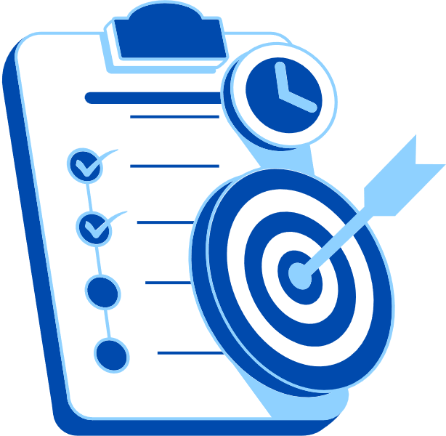
Abstract
Project on Payroll Data Analysis using Power BI with Copilot.
Cleaned and Transformed raw payroll data .
Created KPIs and interactive dashboard.
Used Copilot for AI- assisted insights and automation.
Generated key insights on salary,bonus,and deductions.
Improved accuracy, efficiency,and decision making.

Slide 4

Problem Statement
Payroll data contains errors and inconsistencies.
Issues like duplicate records and incorrect formats.
unstructured data(bonus,overtime,deductions).
Manual analysis is time-consuming and error prone.
Lack of clear insights for decision making
Need for automated and AI -assisted data analysis.

Slide 5

Proposed Solution
Use Power BI for data analysis and visualization .
Clean and transform raw payroll data into structured format.
Remove duplicates and standardize data fields.
Create KPIs using DAX measures
Build an interactive dashboard for insights.
Integrate Microsoft Copilot for AI assisted analysis .
Automate insight generation and improve decision making.

Slide 6
System Architecture
Data Input / Source
Processing / Analysis
Data sourced from Kaggle (Employee Payroll Data )contains employee details like employee ID, department,Salary, Bonus, overtime.
Removed Duplicates, Converted salary field into numeric format,standardized department names,created KPIs using DAX measures.
AI / Tool Integration
Output / Dashboard
Used Microsoft Copilot for AI assistance.
Developed Interactive Power BI dashboard
Displayed key metrics, used charts and enabled better decision making through visualization.

Slide 7
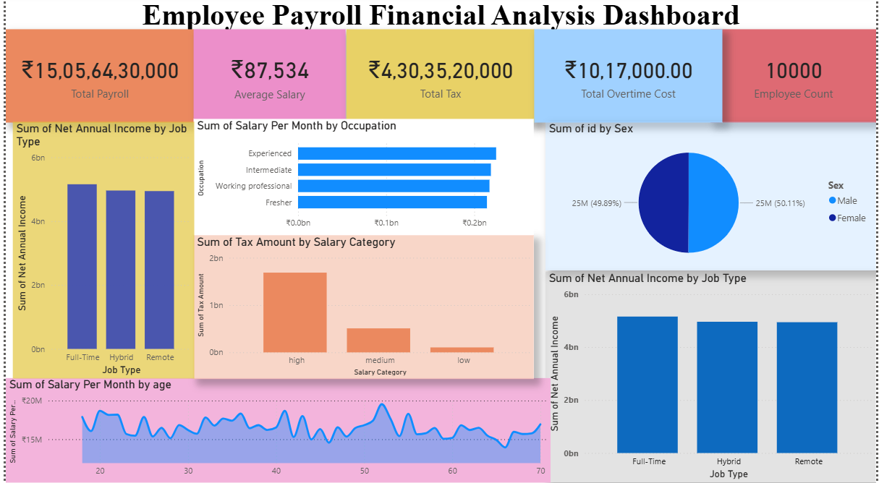
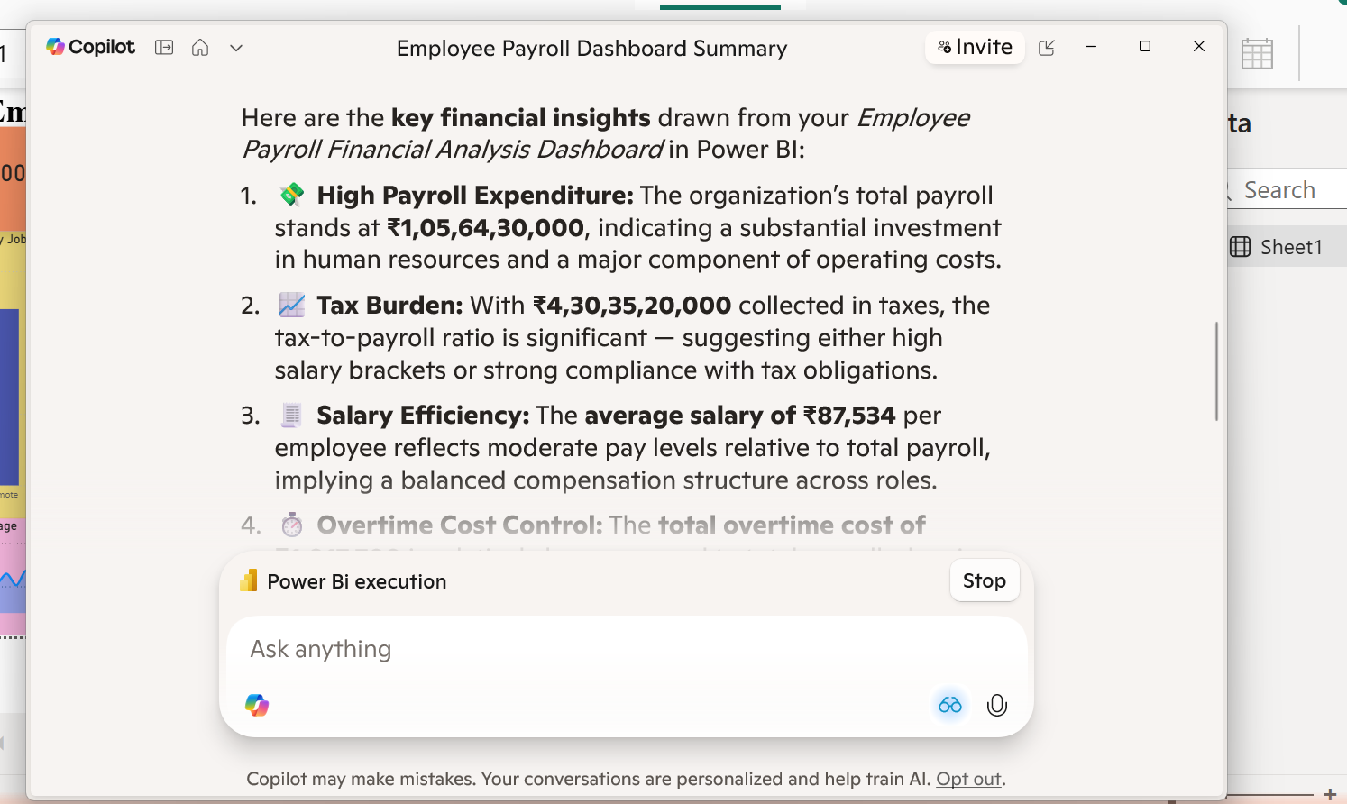
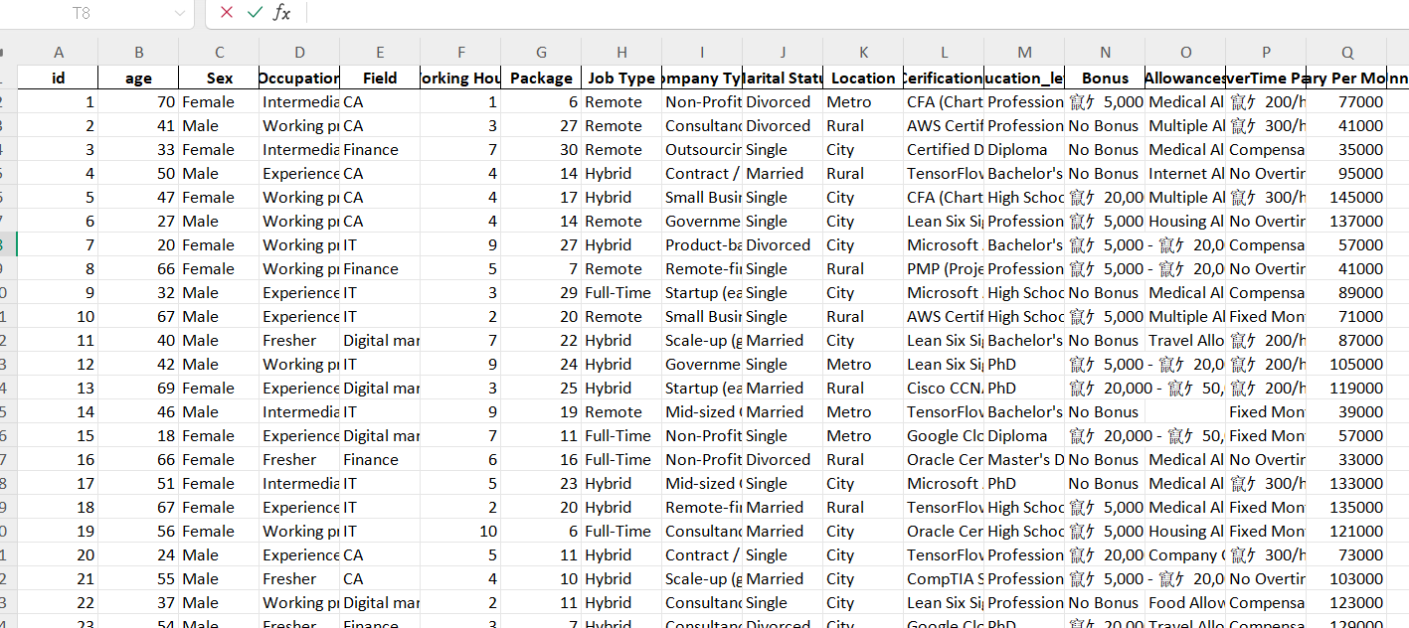
Live Demo of Project
Here's the list of some demo screenshots / features of the project:
Demo 1
Demo 2
Demo 3
[Add description of Demo 1 here — what this demo shows, key features, and results achieved.]
[Add description of Demo 2 here — what this demo shows, key features, and results achieved.]
[Add description of Demo 3 here — what this demo shows, key features, and results achieved.]

Slide 8
Video of Project Demo
]
▶
https://drive.google.com/file/d/1IoRdYPM15DUBdmCSKQcwu0rwBbQrw0fJ/view?usp=sharing

Slide 9

Conclusion
Successfully cleaned and transformed payroll data.
Developed interactive dashboard using Power BI.
Generated key insights on salary,bonus and deductions.
Microsoft Copilot improved efficiency and automation.
Supports better and faster business decision making.
CONCLUSION

Slide 10

Future Scope
Integration with real time payroll systems.
Implementation of predictive analytics
AI based anomaly detection models
Development of automated Payroll monitoring dashboards.
Integration with ERP systems.

Slide 11
Thank You
AICW Fellowship | Student Project Presentation 2026
LinkedIn | Edunet Foundation

